Slide 1

INSTITUTE UIE
DEPARTMENT ACADEMIC UNIT-1
Bachelor of Engineering (Computer Science & Engineering)
Subject Name Semi Conductor Physics
Subject Code 23SPH-143
Prepared By
Dr.Abinash
Experiment-3.1.3
Introduction to Photovoltaic cell,advantages,efficiency.
DISCOVER . LEARN . EMPOWER

Slide 2
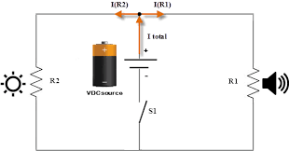
Lecture Objectives
S. No. | Objectives
1 | To make student aware about Photovoltaic Cells.
2 | To aware about working and construction of PV cells
3 | To provide knowledge about types of combination between them.
4 | To make familiar with difference between cell, module and array.
5 | To give brief knowledge about their advantages, disadvantages and efficiency.
https://library.automationdirect.com/basic-electrical-theory/

Slide 3
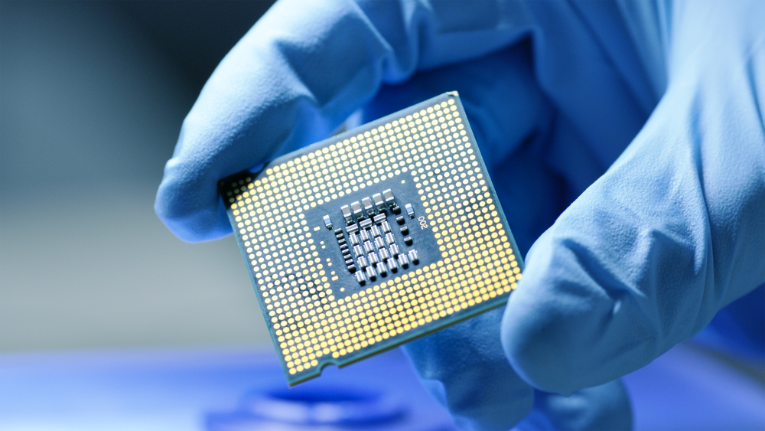
Course Objectives
S. No. | Objectives
1 | To understand the basic materials and properties of semiconductors.
2 | Understand the basic of semiconductor and components like diode, transistor, FET, MOSFET and Energy Sources.
3 | To give knowledge about semiconductor physics and discus working and applications of basic devices, including p-n junctions, BJTs and FETs.
https://www.iqsdirectory.com/resources/everything-you-ever-wanted-to-know-about-semiconductors/

Slide 4

Course Outcomes
S.NO | Description | Blooms’ Taxonomy Level
CO1 | To apply the knowledge of basic semiconductor material physics and understand fabrication processes. | EASY
CO2 | To understand the characteristics of different electronic devices such as diodes, transistors. | MEDIUM
CO3 | To derive the relationships between the parameters in diode, FET, configurations of Transistor and MOSFETs. | MEDIUM
CO4 | To describe the working and design considerations for the various photonic devices like photo detectors, solar-cells and LEDs. | HARD
CO5 | To provide problem solving experience and learning of concepts through it in semiconductor physics. | HARD
https://lot.dhl.com/5-things-the-current-semiconductor-slowdown-tells-us-about-the-global-economy/

Slide 5
Importance of Photovoltaic Systems
Unlike the existing systems, the utmost advantage is its being able to produce electricity freely without any need of fossil fuel and connection.
Used fuel can be found free and in everyplace. They have no problems regarding carrying and storage.
They need low maintenance due to that the moving parts used in the system are low.
The other systems used in producing electricity ( generators, wind and hydroelectric turbines etc.) need to systematic maintenance. If your PV system is complicated, It need a little bit maintenance but in general it can be called these systems as ‘’ free-maintenance’’.
Comparing the other electric generation systems, probably their utmost advantage is their reliability. Their moving parts are almost non-existing. They resist to natural events like lightnings, tough winds or sand storms, moisture and heat, snow or glacial.

Slide 6
Content
Introduction to Photovoltaic cell.
PV cell working.
PV cell construction
PV cell, module and array
Advantages and disadvantages of PV cell technology
I-V characteristics of PV cell
Efficiency of PV cell

Slide 7
Introduction
Solar power is an indefinitely renewable source of energy as the sun has been radiating an estimated 5000 trillion kWh of energy for billions of years and will continue to do so for the next 4 billion years. Solar energy is a form of energy which is used in power cookers, water heaters etc. The primary disadvantage of solar power is that it cannot be produced in the absence of sunlight. This limitation is overcome by the use of solar cells that convert solar energy into electrical energy. Solar Energy is defined as the radiating light and heat from the sun that is harnessed using devices like heaters, solar cookers, and photovoltaic cells to convert it to other forms of energy such as electrical energy and heat. In this section, we will learn about the photovoltaic cell, its advantages, and disadvantages.

Slide 8
Introduction- contd…
Definition: A photovoltaic (PV) cell is an energy harvesting technology, that converts solar energy into useful electricity through a process called the photovoltaic effect. There are several different types of PV cells which all use semiconductors to interact with incoming photons from the Sun in order to generate an electric current.
History: A photovoltaic (PV) cell, also known as a solar cell, is an electronic component that generates when exposed to photons, or particles of light. This conversion is called the, which was discovered in 1839 by French physicist Edmond Becquerel1. It was not until the 1960s that photovoltaic cells found their first practical application in satellite technology. Solar panels, which are made up of PV cell modules, began arriving on rooftops at the end of the 1980s. Photovoltaic capacity has been growing steadily since the start of the 21st century, led by the construction of huge solar farms.

Slide 9
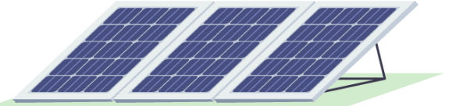
Fig. 1 Solar Panel

Slide 10
Working of PV Cell
The Photovoltaic cell is the semiconductor device that converts the light into electrical energy. The voltage induces by the PV cell depends on the intensity of light incident on it. The name Photovoltaic is because of their voltage producing capability. Photovoltaic cells consist of two or more layers of semiconductors with one layer containing positive charge and the other negative charge lined adjacent to each other.
Sunlight, consisting of small packets of energy termed as photons, strikes the cell, where it is either reflected, transmitted or absorbed. When the photons are absorbed by the negative layer of the photovoltaic cell, the energy of the photon gets transferred to an electron in an atom of the cell. With the increase in energy, the electron escapes the outer shell of the atom. The freed electron naturally migrates to the positive layer creating a potential difference between the positive and the negative layer. When the two layers are connected to an external circuit, the electron flows through the circuit, creating a current.

Slide 11
Working of PV cell
The electrons of the semiconductor material are joined together by the covalent bond. The electromagnetic radiations are made of small energy particles called photons. When the photons are incident on the semiconductor material, then the electrons become energised and starts emitting. The energised electron is known as the Photoelectrons. And the phenomenon of emission of electrons is known as the photoelectric effect. The working of the Photovoltaic cell depends on the photoelectric effect.

Slide 12
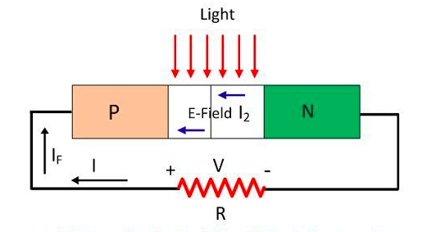
Working of PV cell
Consider the figure below shows the PV cell made of silicon and the resistive load is connected across it. The PV cell consists the P and N-type layer of semiconductor material. These layers are joined together to form the PN junction.
Fig.2. PV Cell with load resistance

Slide 13
Working of PV cell
The light incident on the semiconductor material may be pass or reflected through it. The PV cell is made of the semiconductor material which is neither a complete conductor nor an insulator. This property of semiconductor material makes it more efficient for converting the light energy into electric energy.
When the semiconductor material absorbs light, the electrons of the material starts emitting. This happens because the light consists small energised particles called photons. When the electrons absorb the photons, they become energised and starts moving into the material. Because of the effect of an electric field, the particles move only in the one direction and develops current. The semiconductor materials have the metallic electrodes through which the current goes out of it.

Slide 14
Construction of Photovoltaic Cell
The semiconductor materials like arsenide, indium, cadmium, silicon, selenium and gallium are used for making the PV cells. Mostly silicon and selenium are used for making the cell. Consider the figure below shows the constructions of the silicon photovoltaic cell. The upper surface of the cell is made of the thin layer of the p-type material so that the light can easily enter into the material. The metal rings are placed around p-type and n-type material which acts as their positive and negative output terminals respectively.

Slide 15
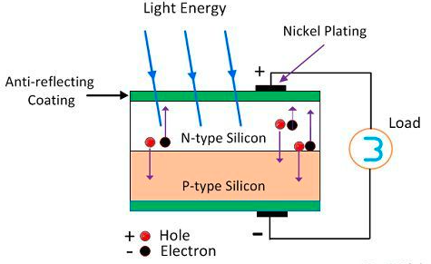
Construction of Photovoltaic Cell
Fig.3 PV Cell Construction

Slide 16
Construction of Photovoltaic Cell
The multi-crystalline or monocrystalline semiconductor material make the single unit of the PV cell. The mono-crystal cell is cut from the volume of the semiconductor material. The multicell are obtained from the material which has many sides. The output voltage and current obtained from the single unit of the cell is very less. The magnitude of the output voltage is 0.6V, and that of the current is 0.8A. The different combinations of cells are used for increasing the output efficiency. There are three possible ways of combining the PV cells.

Slide 17
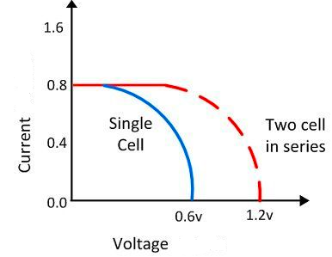
PV cell combinations
Series Combination of PV Cells: If more than two cells are connected in series with each other, then the output current of the cell remains same, and their input voltage becomes doubles. The graph below shows the output characteristic of the PV cells when connected in series.
Fig.4 PV Cell Characteristics for series combination

Slide 18
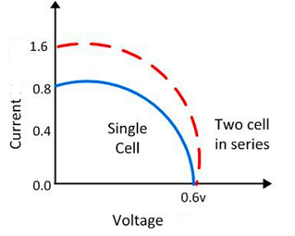
PV cell combinations
Parallel Combination of PV cells
In the parallel combination of the cells, the voltage remains same, and the magnitude of current becomes double. The characteristic curve of the parallel combination of cells is represented below.
Fig.5 PV Cell Characteristics for parallel combination

Slide 19
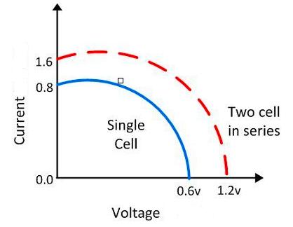
PV cell combinations
Series-Parallel Combination of PV cells
In the series-parallel combination of cells the magnitude of both the voltage and current increases. Thereby, the solar panels are made by using the series-parallel combination of the cells.
Fig.6 PV Cell Characteristics for series-parallel combination

Slide 20
Advantages of PV cell
Environmental Sustainability: Photovoltaic cells generate clean and green energy as no harmful gases such as COx, NOx etc are emitted. Also, they produce no noise pollution which makes them ideal for application in residential areas.
Economically Viable:The operation and maintenance costs of cells are very low. The cost of solar panels incurred is only the initial cost i.e., purchase and installation.
Accessible: Solar panels are easy to set up and can be made accessible in remote locations or sparsely inhabited areas at a lesser cost as compared to conventional transmission lines. They are easy to install without any interference with the residential lifestyle.
Renewable: Energy is free and abundant in nature.
Cost: Solar panels have no mechanically moving parts except in some highly advanced sunlight tracking mechanical bases. Consequently, the solar panel price for maintenance and repair is negligible.

Slide 21
Disadvantages of PV cell
The efficiency of solar panels is low compared to other renewable sources of energy.
Energy from the sun is intermittent and unpredictable and can only be harnessed in the presence of sunlight. Also, the power generated gets reduced during cloudy weather.
Long-range transmission of solar energy is inefficient and difficult to carry. The current produced is DC in nature and the conversion of DC current to AC current involves the use of additional equipment such as inverters.
Photovoltaic panels are fragile and can be damaged relatively easily. Additional insurance costs are required to ensure a safeguard of the investments.

Slide 22
PV module, panel and array
Photovoltaic cells are connected electrically in series and/or parallel circuits to produce higher voltages, currents and power levels. Photovoltaic modules consist of PV cell circuits sealed in an environmentally protective laminate, and are the fundamental building blocks of PV systems. Photovoltaic panels include one or more PV modules assembled as a pre-wired, field-installable unit. A photovoltaic array is the complete power-generating unit, consisting of any number of PV modules and panels.

Slide 23
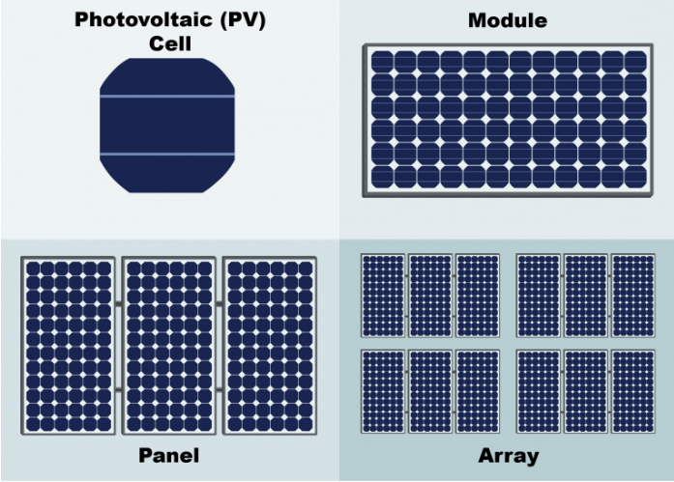
Fig.7 PV Cell, Module, panel and Array

Slide 24
PV module, panel and array
The performance of PV modules and arrays are generally rated according to their maximum DC power output (watts) under Standard Test Conditions (STC). Standard Test Conditions are defined by a module (cell) operating temperature of 25o C (77o F), and incident solar irradiance level of 1000 W/m2 and under Air Mass 1.5 spectral distribution. Since these conditions are not always typical of how PV modules and arrays operate in the field, actual performance is usually 85 to 90 percent of the STC rating.
Today’s photovoltaic modules are extremely safe and reliable products, with minimal failure rates and projected service lifetimes of 20 to 30 years. Most major manufacturers offer warranties of 20 or more years for maintaining a high percentage of initial rated power output.

Slide 25
Characteristics of PV cell
The I-V characteristics curve usually defines the PV cell performance. A combined performance of all the solar cell in a module defines a I-V characteristics of a PV module and similarly it also defines I-V characteristics of a string.
Short circuit current (ISC) – It is the maximum current that can flow through a cell when the voltage across the solar cell is zero (0) (i.e., when the solar cell is short circuited). It is denoted by ISC.
Open circuit voltage (VOC) – It is the maximum voltage a solar cell can produce when no load is connected to it (i.e., measures with a multimeter across the open ends of the wires). It is denoted by VOC.

Slide 26
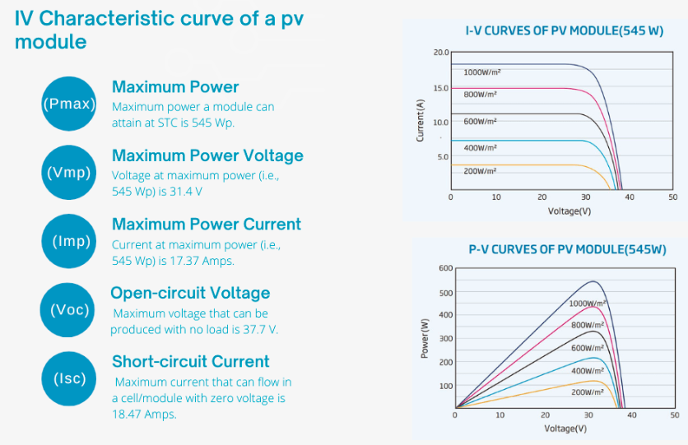
Characteristics of PV cell
The following figure shows the I-V characteristics curve, P-V characteristics curve and datasheet of a PV module. The vertical axis denotes the current (I) while the horizontal axis denotes the voltage (V). Following terms are defined to understand the I-V characteristics curve: –
Fig.8 Characteristics of PV Cell

Slide 27
Characteristics of PV cell
In a typical 545 Wp module, the short circuit current (ISC) is 18.47 Amps and Open circuit voltage (VOC) is 37.7 V, both measured at standard test condition (STC). The power output from the solar module is the product of current and voltage at a particular instant on the I-V characteristics curve. The highest power output is realised at a particular point on the I-V characteristics curve which is known as Maximum Power Point Tracking (MPPT) and the respective current and voltage are known as Current at maximum power (IMPP) voltage at maximum power (VMPP). Typically, the I-V characteristics curve is drawn at one sun radiation (1000 W/m2) however, variation in solar radiation value predominantly changes the current output from the solar panel and subsequently the power output. The output voltage from solar panel is highly dependent on the operating temperature of the solar cells. With increase in temperature the open circuit voltage (VOC) of cells reduces which is defined as temperature co-efficient of solar panel.

Slide 28
Efficiency of PV cell
Efficiency is the comparison of energy output to energy input of a given system. For solar photovoltaic (PV) cells, this means the ratio of useful electrical energy they produce to the amount of solar energy incident on the cell under standardized testing conditions. Although some experimental solar cells have achieved efficiencies of close to 50%, most commercial cells are below 30%.
Solar-cell efficiency refers to the portion of energy in the form of sunlight that can be converted via photovoltaics into electricity by the solar cell.
The efficiency of the solar cells used in a photovoltaic system, in combination with latitude and climate, determines the annual energy output of the system. For example, a solar panel with 20% efficiency and an area of 1 m2 will produce 200 kWh/yr at Standard Test Conditions if exposed to the Standard Test Condition solar irradiance value of 1000 W/m2 for 2.74 hours a day. Usually solar panels are exposed to sunlight for longer than this in a given day, but the solar irradiance is less than 1000 W/m2 for most of the day. A solar panel can produce more when the sun is high in the sky and will produce less in cloudy conditions or when the sun is low in the sky, usually the sun is lower in the sky in the winter.

Slide 29

Efficiency of PV cell
The efficiency of a solar cell is determined as the fraction of incident power which is converted to electricity and is defined as:
Where: V_{oc} is the open-circuit voltage; I_{sc} is the short-circuit current; FF is the fill factor and η is the efficiency.
The input power for efficiency calculations is 1 kW/m² or 100 mW/cm². Thus the input power for a 100 × 100 mm² cell is 10 W and for a 156 × 156 mm² cell is 24.3 W

Slide 30
Summary
Introduction to Photovoltaic cell.
PV cell working.
PV cell construction
PV cell, module and array
Advantages and disadvantages of PV cell technology
I-V characteristics of PV cell
Efficiency of PV cell

Slide 31
Frequently Asked Questions
Q1 How do solar cells work?
A solar panel works by allowing particles of light, or photons, to knock electrons free from atoms, generating a flow of electricity.
Q2 What is the principle of solar cells?
Silicon crystals are laminated into p-type and n-type layers, stacked on top of each other. Light striking the crystals induces the “photovoltaic effect,” which generates electricity.
Q3 State true or false: Solar energy is a renewable form of energy.
TRUE.
Q4 What does the solar cell include?
Solar cell consists of a crystalline silicon solar panel which is a series of interconnected silicon cells joined together to form a circuit.
Q5 Can solar power from photovoltaic cells be harnessed in the absence of sunlight?
No, it can be only harnessed in the presence of sunlight.

Slide 32

LEARNING OUTCOMES
To make students understand
Concepts of Photovoltaic systems
Construction and working of PV cells
Characteristics and efficiency of PV cells

Slide 33
Assessment Pattern
A Assignment (each assignment) | B Time Bound Surprise Test (each test) | C Quiz (each quiz) | D Mid Semester Test(one per test) | E Homework | F Discussion Forums | G Attendance and engagement Score on BB
10 | 12 | 4 | 20 | NA | NA | 2

Slide 34
References
Websites:
https://circuitglobe.com/photovoltaic-or-solar-cell.html
https://byjus.com/physics/solar-energy-and-photovoltaic-cell/
https://energyeducation.ca/encyclopedia/Photovoltaic_cell
https://www.planete-energies.com/en/media/article/how-does-photovoltaic-cell-work
https://www.firstgreen.co/i-v-characteristics-curves-for-solar-panels/
https://www.pveducation.org/pvcdrom/solar-cell-operation/iv-curve
Online Books:
https://www.researchgate.net/publication/304513870_Basics_of_Electrical_Engineering_-_a_text_book_for_first_year_B_Tech_students_of_Engineering_all_specializations
https://electricalanswers.files.wordpress.com/2014/09/a-textbook-of-electrical-technology-volume-i-basic-electrical-engineering-b-l-theraja.pdf
https://drive.google.com/file/d/1Q8OXkp--k5TJtZ4TjBeZEIQGcyjh8VO6/view

Slide 35
References
Video:
https://www.youtube.com/watch?v=HvoNJJS5dkc
https://www.youtube.com/watch?v=X0OZ6tpZ3Mc
https://www.youtube.com/watch?v=L_q6LRgKpTw
Text Books:
P. Wurfell , “Physics of Solar Cells: From Basic Principles to Advanced Concepts”, Wiley, 2009
J Nelson, "The Physics of Solar Cells" , Imperial College Press, 2003
Martin A Green, "Solar Cells: Operating Principles, Technology and System Applications", Prentice Hall Series, 1982
V.N. Mittle “Basic Electrical Engineering”, Tata McGraw Hill Edition, New Delhi, 1990.
Electrical Technology by Surinder Pal Bali, Pearson Publications.
R.S. Sedha, “Applied Electronics” S. Chand & Co., 2006.
Electronic Devices and Circuits, R.L. Boylestad and Louis Nashelsky, 9th edition, PEI/PHI 2006.

